Slide 1

Non-volatile Memory
Computer System Principles, Fall 2020 (IPADS, SJTU)
An emerging technology
Yubin Xia
Some slides from http://research.cs.wisc.edu/sonar/tutorial/

Slide 2
NVM: What & Why
What is non-volatile memory?

Slide 3
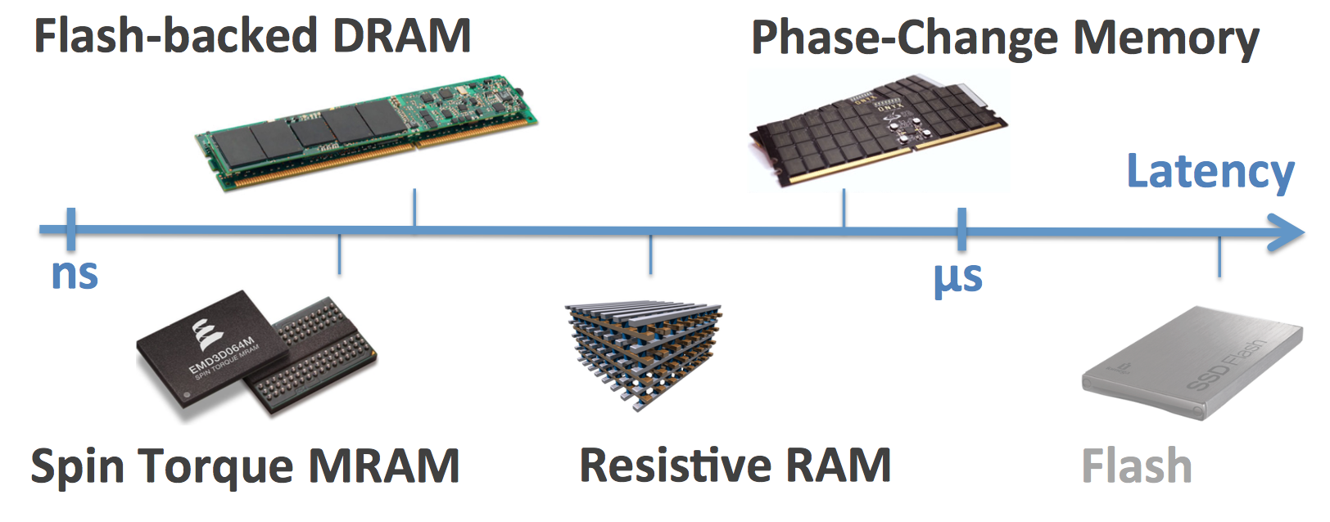
NVM Technologies
Persistent
Short access time
Byte addressable

Slide 4
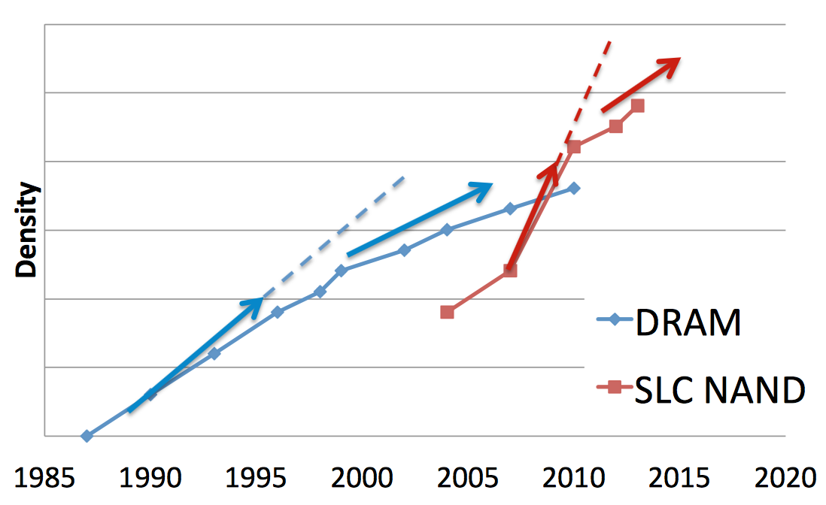
NVDIMM
Store data in DRAM backed by NAND Flash
Capacity is hard to scale

Slide 5
Phase-Change Memory (PCM)
Store data within phase-change material
  Amorphous phase: high resistivity (0)
  Crystalline phase: low resistivity (1)
Set phase via current pulse
  Fast cooling → Amorphous
  Slow cooling → Crystalline

Slide 6
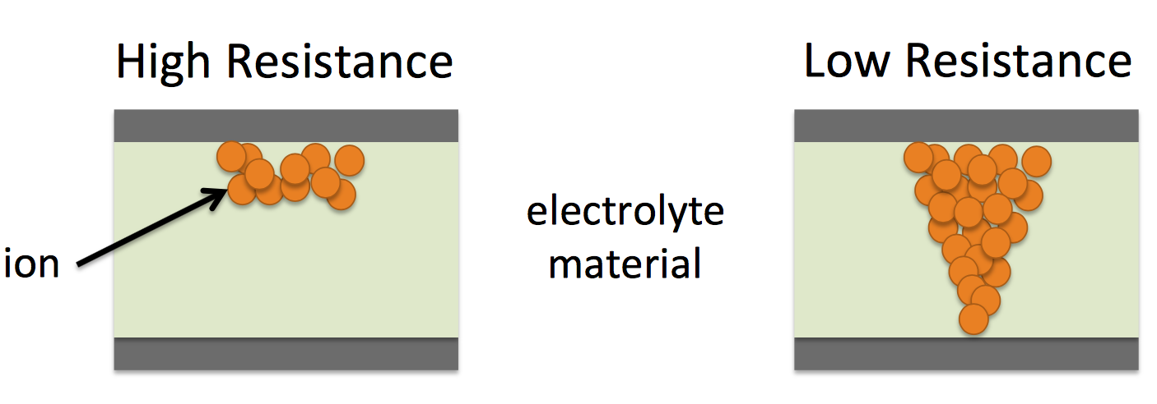
Resistive RAM (RRAM)
Store data by dissolving ions within electrolyte memristive material (e.g., TiOx)

Slide 7
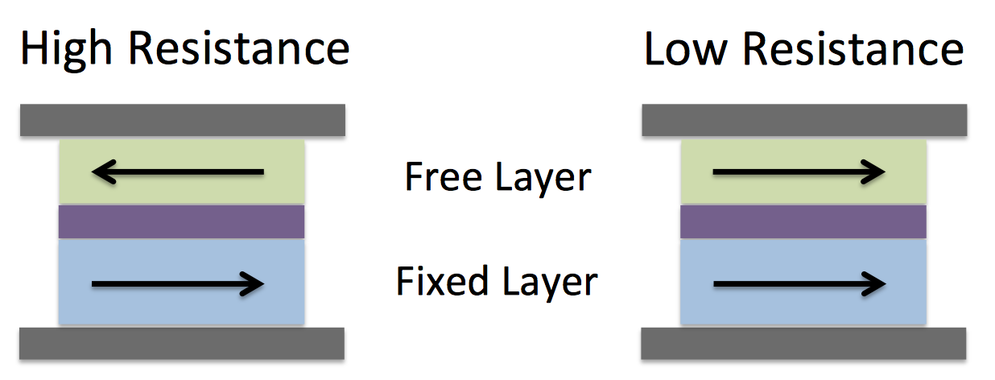
Spin-Transfer Torque RAM (STT-RAM)
Store data within magnetic-tunnel junction
  Anti-parallel orientation: high resistance (0)
  Parallel orientation: low resistance (1)

Slide 8
3D-XPoint
Figure from https://fortune.com/2015/07/28/intel-micron-memory/
Notes:
Original link (broken): http://www.intelsalestraining.com/memorytimeline/

Slide 9
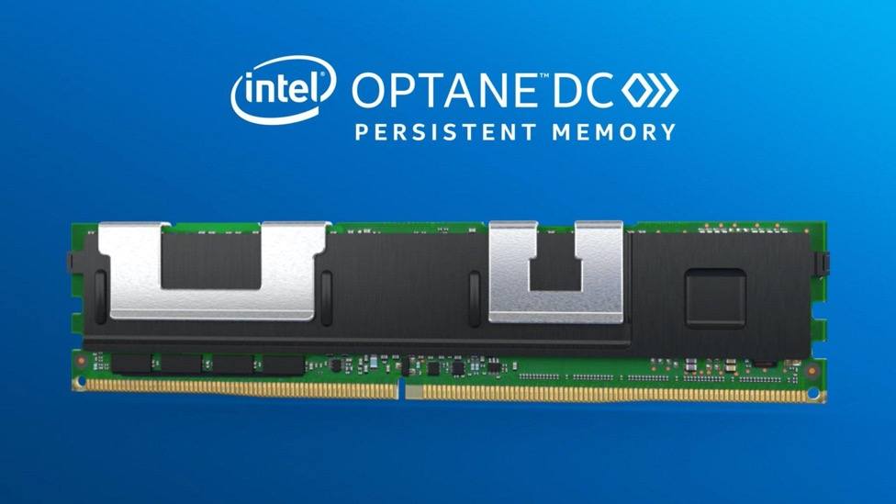
Intel Optane DC Persistent Memory
Available last year
Figure from Intel, https://www.intel.com/content/www/us/en/architecture-and-technology/optane-dc-persistent-memory.html

Slide 10
Summary

Slide 11
Where to use

Slide 12
Ecosystem Overview
Applications
read/write
read/write
mmap
NVM Library
NVM Library / libFS
&
kernel module
user
mmap
kernel
DiskFS
NVMFS
Direct to NVM
(XIP/DAX)
Block I/O
BTT
load/store
Byte-addressable NVM (Persistent Memory)

Slide 13
DiskFS on NVM
Applications
Traditional DiskFS
  Ext2/3/4, XFS, BtrFS, F2FS,...
Block Translation Table (BTT)
  Block interface over NVM
  Atomicity
read/write
user
kernel
DiskFS
Block I/O
BTT
NVM
Q: Why DiskFS on NVM?

Slide 14
NVMFS
Applications
Designed for NVM
  BPFS, PMFS, NOVA, SoupFS,...
Direct Access (DAX)
  Direct load/store on NVM
  Exposed to app using mmap
read/write
mmap
user
kernel
NVMFS
Direct to NVM
(XIP/DAX)
load/store
NVM

Slide 15
NVM Library over FS
Applications
Relies on FS
  PMDK,...
  FS organizes the space
  Library/App controls how to use
Interfaces
  Objects, transactions, memory pool,...
read/write
mmap
NVM Library
user
mmap
kernel
NVMFS
Direct to NVM
(XIP/DAX)
load/store
NVM
Q: Why are they built upon FS?

Slide 16
NVM Library / libFS with Kernel Module
Applications
User-kernel space co-design
  Mnemosyne, Aerie,...
  Better performance
Interfaces
  Objects, transactions, memory pool,...
  FS
NVM Library / libFS
&
kernel module
user
kernel
load/store
NVM

Slide 17
Ecosystem Overview
Applications
read/write
read/write
mmap
NVM Library
NVM Library / libFS
&
kernel module
user
mmap
kernel
DiskFS
NVMFS
Direct to NVM
(XIP/DAX)
Block I/O
BTT
load/store
Byte-addressable NVM (Persistent Memory)

Slide 18
Why?
Why FS?
  FS interfaces matter
  Backward compatibility
Why NVMFS?

Slide 19
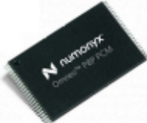

DiskFS
App
App
FS designed for block-based disks
  Needs BTT for correctness
  Too many layers leading to inefficiency
System call interface
VFS
DiskFS
Generic Block Layer
I/O Scheduler
Device Driver
(including BTT)
Device Driver
Memory Bus
I/O Bus

Slide 20
NVMFS
App
FS designed for byte-addressable NVM
  Simplified stack
  High performance
System call interface
VFS
Byte-addressability
NVMFS
Const. access latency
Generic Block Layer
I/O Scheduler
load/store interface
Device Driver
(including BTT)
Memory Bus

Slide 21
Challenges
Nothing comes free in life...

Slide 22
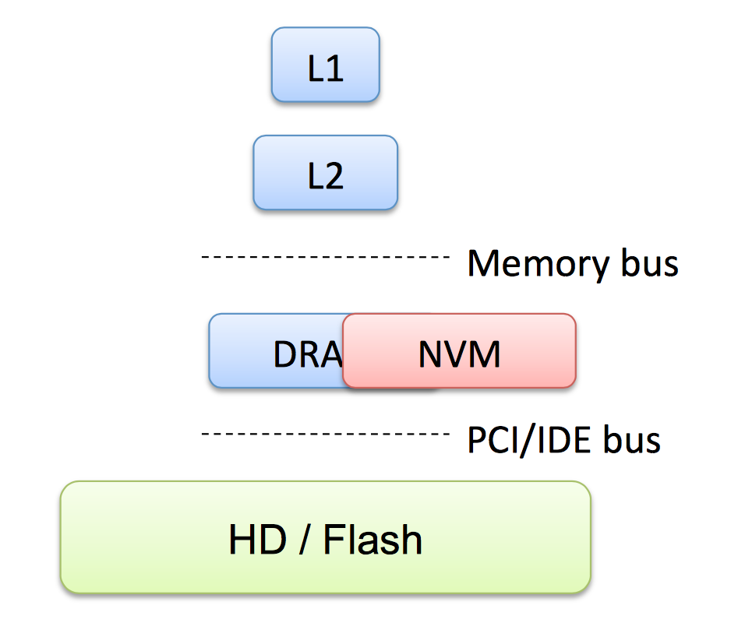
Cache and Write-back
 | DISK | NVM
Data cached in | DRAM | CPU cache
Write-back controlled by | Software | Hardware

Slide 23
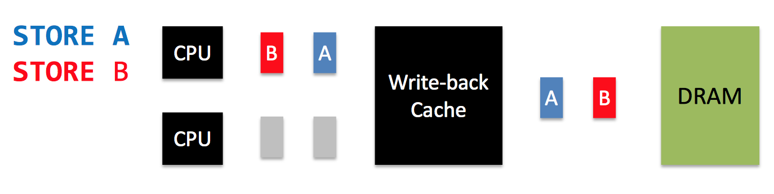
Volatile Memory Ordering
Write-back caching
  Improves performance
  Reorders writes to DRAM
Reordering to DRAM does not break correctness

Slide 24
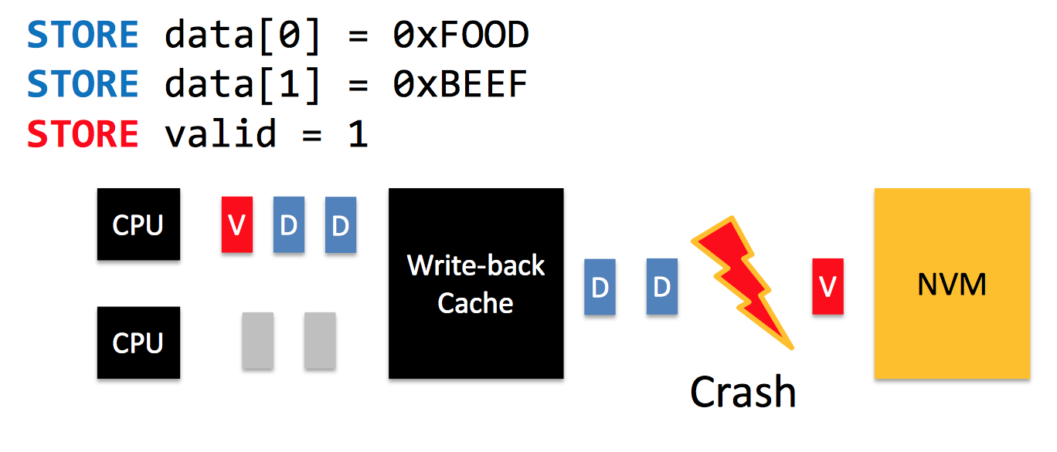
Non-volatile Memory Ordering
Recovery depends on write ordering

Slide 25
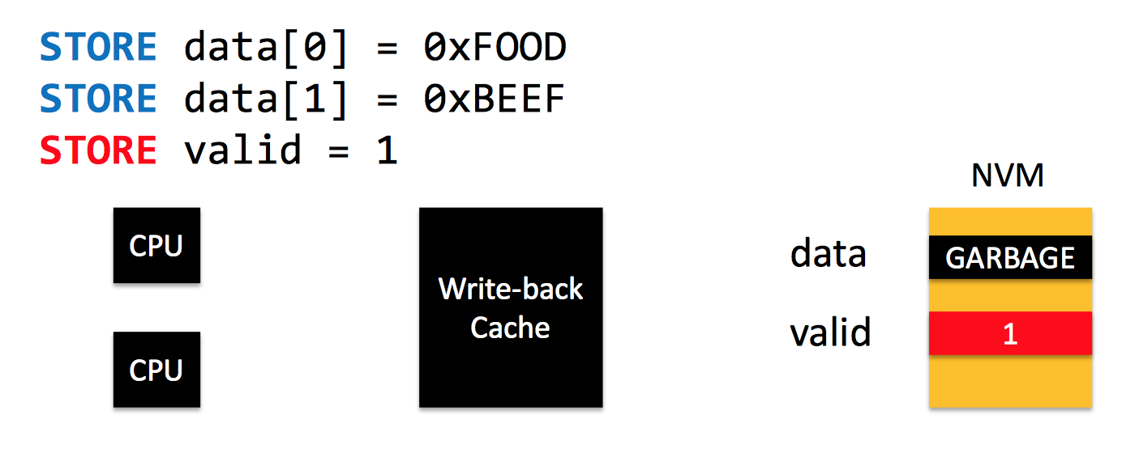
Non-volatile Memory Ordering
Recovery depends on write ordering
Reordering breaks recovery
Recovery incorrectly considers garbage as valid data

Slide 26
Simple Solutions
Disable caching
Write-through caching
Flush entire cache at commit
Significantly affect performance!

Slide 27
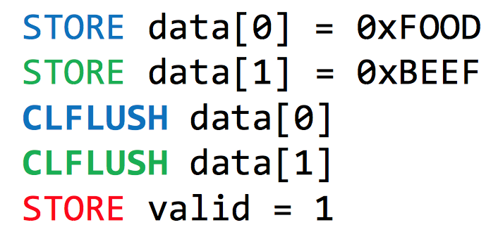
Ordering with Existing Hardware
Order writes by flushing cachelines via CLFLUSH
But CLFLUSH
  Stalls the CPU pipeline and serializes execution
  Invalidates the cacheline

Slide 28
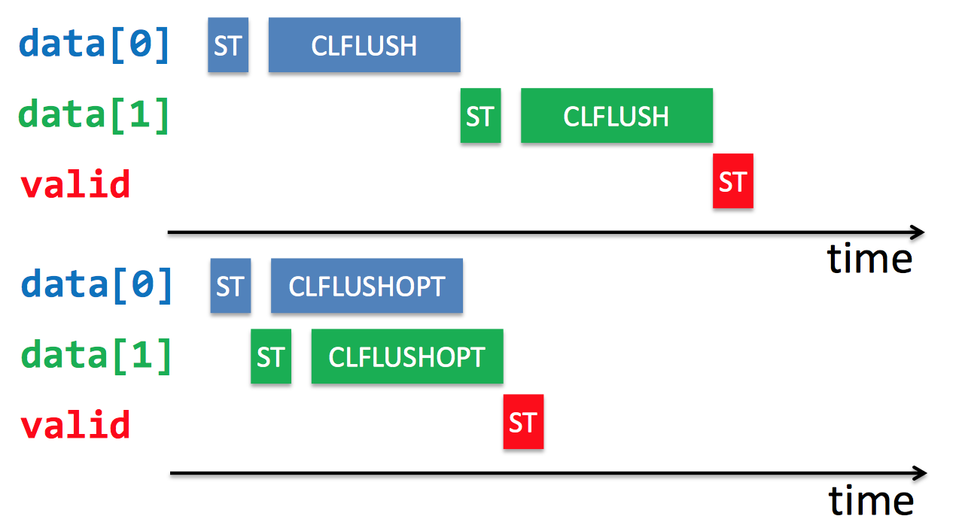
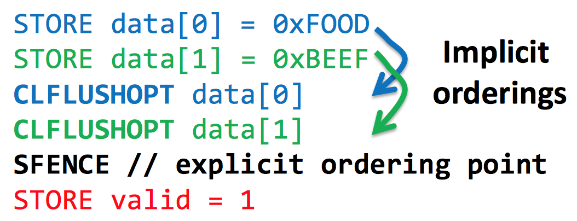
Fixing CLFLUSH: Intel x86 Extensions
CLFLUSHOPT
  Unordered version of CLFLUSH
CLWB
  Same as CLFLUSHOPT
  Does not invalidate cache

Slide 29
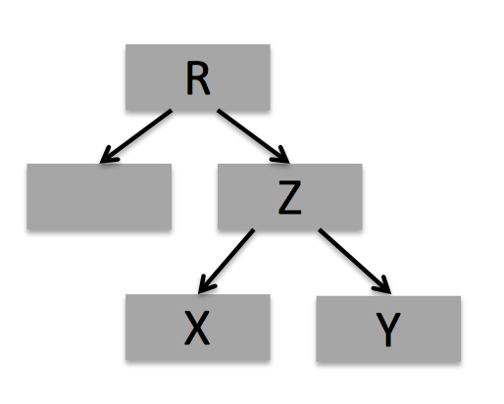
Example: Copy-on-Write

Slide 30
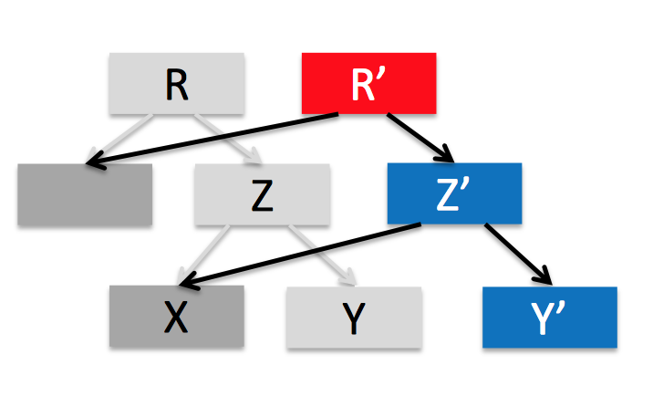
Example: Copy-on-Write
STORE Y’
STORE Z’
CLWB Y’
CLWB Z’
SFENCE
STORE R’
CLWB R’

Slide 31
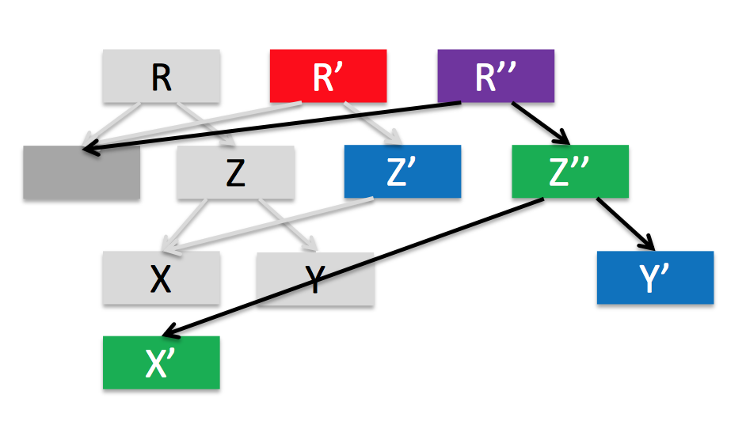
Example: Copy-on-Write
STORE Y’
STORE Z’
CLWB Y’
CLWB Z’
SFENCE
STORE R’
CLWB R’
SFENCE
STORE X’
STORE Z’’
CLWB X’
CLWB Z’’
SFENCE
STORE R’
CLWB R’

Slide 32
Case study: BPFS
Back to NVMFS
[Condit, SOSP’09]

Slide 33
BPFS: A BPRAM File System
Guarantees that all file operations execute atomically and in program order
Despite guarantees, significant performance improvements over NTFS on the same media
Short-circuit shadow paging often allows
atomic, in-place updates

Slide 34
BPFS: A BPRAM File System
root pointer
indirect blocks
inode
file
inodes
file
directory
file

Slide 35
Enforcing FS Consistency Guarantees
What happens if we crash during an update?
  Disk: Use journaling or shadow paging
  BPRAM: Use short-circuit shadow paging

Slide 36
Review 1: Journaling
Write to journal, then write to file system
file system
A
A’
B
B’
journal
A’
B’
Reliable, but all data is written twice

Slide 37
Review 2: Shadow Paging
Use copy-on-write up to root of file system
file’s root pointer
A
B
A’
B’
Any change requires bubbling to the FS root
Small writes require large copying overhead

Slide 38
Short-Circuit Shadow Paging
Inspired by shadow paging
  Optimization: In-place update when possible

Slide 39
Short-Circuit Shadow Paging
Inspired by shadow paging
  Optimization: In-place update when possible
file’s root pointer
A
B
A’
B’
Uses byte-addressability and atomic 64b writes

Slide 40
Opt. 1: In-Place Writes
Aligned 64-bit writes are performed in place
  Data and metadata
file’s root pointer
in-place write

Slide 41
Opt. 2: Exploit Data-Metadata Invariants
Appends committed by updating file size
file’s root pointer + size
file size update
in-place append

Slide 42
BPFS Example
root pointer
indirect blocks
inode
file
inodes
add entry
remove entry
directory
directory
file
Cross-directory rename bubbles to common ancestor

Slide 43
Case study: PMFS
Another
[Kumar, EuroSys’14]

Slide 44
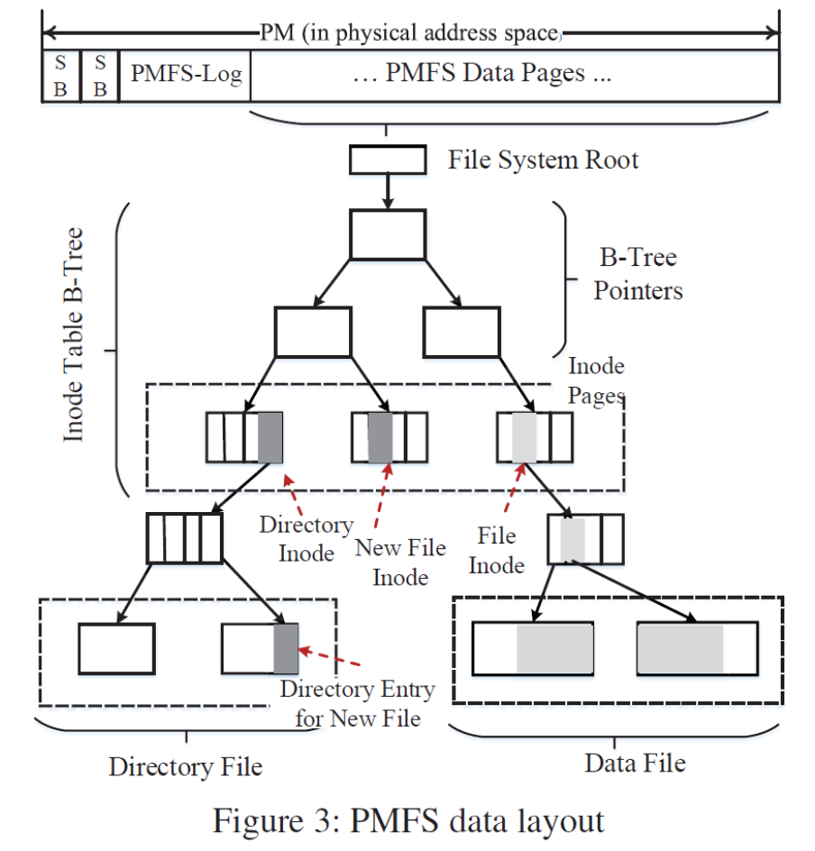
PMFS Layout

Slide 45
Consistency
Used for updates on Data Area
Three existing techniques:
  Copy-on-Write (Shadow Paging)
  Journaling
  Log-structured updates
One more NVM specific technique
  Atomic in-place writes
Used for updates on Metadata (e.g. inodes)
Used for updates of small portion of data

Slide 46
Extended Atomic In-place Writes
8 bytes
  CPU natively supports 8-byte atomic writes
  Update inode’s access time
16 bytes
  Using cmpxchg16b instruction
  Update inode’s size and modification time
64 bytes
  Using RTM (introduced in Haswell)
  Update a number of inode fields like delete

Slide 47
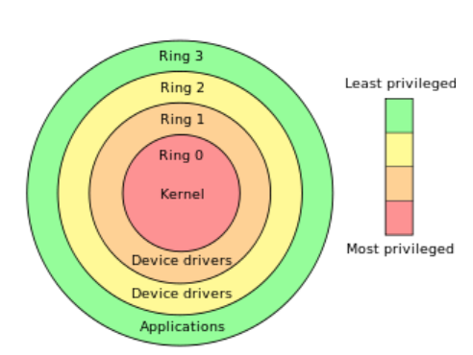
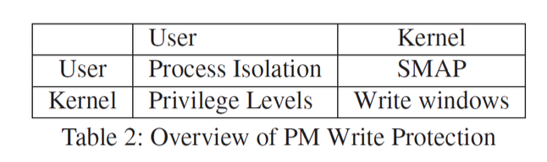
Write Protection Stray Writes
Supervisor Mode Access Protection (SMAP)
  Prohibit writes into user area
Write windows (introduced in PMFS)
  Mount as read-only
  When writing, CR0.WP is set to zero
Right) http://en.wikipedia.org/wiki/Protection_ring

Slide 48
Case study: NOVA
One more
[Xu, FAST’16]

Slide 49
A Log-structured File System
Log-structuring provides cheaper atomicity than journaling and shadow paging
NVMM supports fast, highly concurrent random accesses
  Using multiple logs does not negatively impact performance
  Log does not need to be contiguous
Rethink and redesign log-structuring entirely

Slide 50
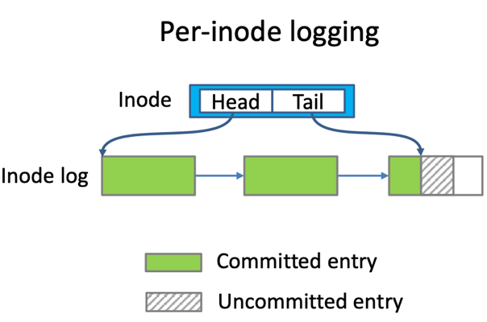
NOVA design goals
Atomicity
  Combine log-structuring, journaling and copy-on-write
High performance
  Split data structure between DRAM and NVM
Efficient garbage collection
  Fine-grained log cleaning with log as a linked list
  Log only contains metadata
Fast recovery
  Lazy rebuild
  Parallel scan

Slide 51
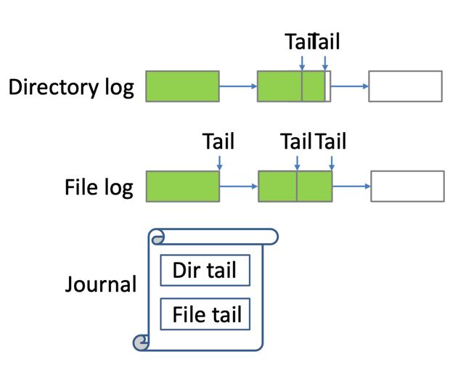
Atomicity
Log-structuring for single log update
  Write, msync, chmod, etc
  Strictly commit log entry to NVMM before updating log tail
Lightweight journaling for update across logs
  Unlink, rename, etc
  Journal log tails instead of metadata or data
Copy-on-write for file data
  Log only contains metadata
  Log is short

Slide 52
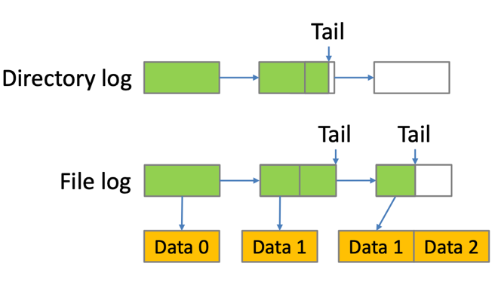
Atomicity
Log-structuring for single log update
  Write, msync, chmod, etc
  Strictly commit log entry to NVMM before updating log tail
Lightweight journaling for update across logs
  Unlink, rename, etc
  Journal log tails instead of metadata or data
Copy-on-write for file data
  Log only contains metadata
  Log is short

Slide 53
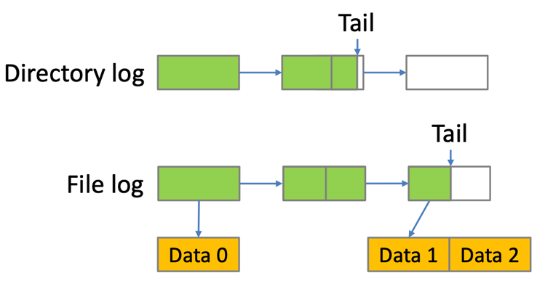
Performance
Per-inode logging allows for high concurrency
Split data structure between DRAM and NVM
  Performance log is simple and efficient
  Volatile tree structure has no consistency overhead

Slide 54
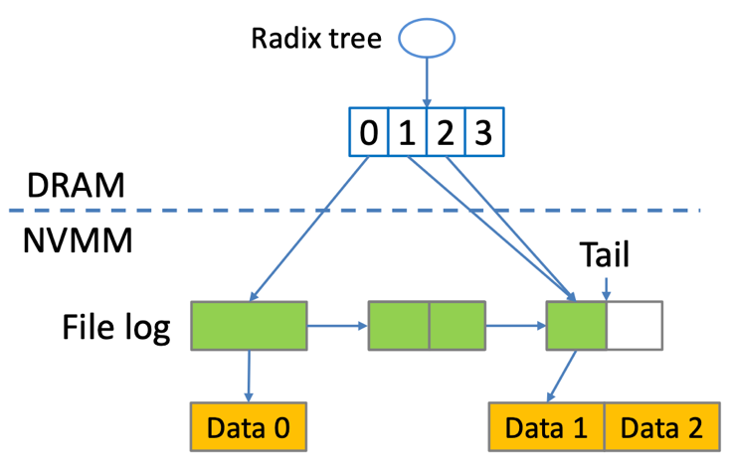
Performance
Per-inode logging allows for high concurrency
Split data structure between DRAM and NVM
  Performance log is simple and efficient
  Volatile tree structure has no consistency overhead

Slide 55
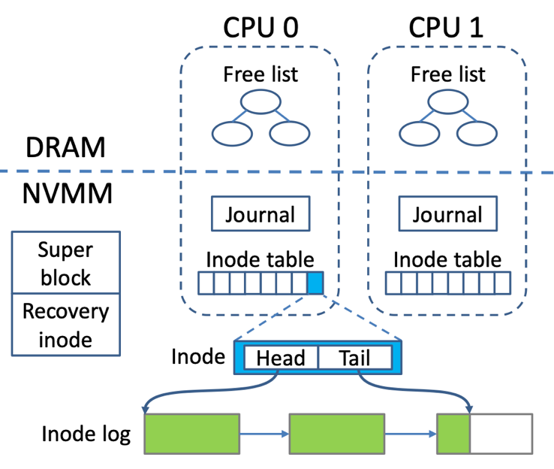
NOVA layout
Put allocator in DRAM
High scalability
  Per-CPU NVM free list, journal and inode table
  Concurrent transactions and allocation/deallocation

Slide 56
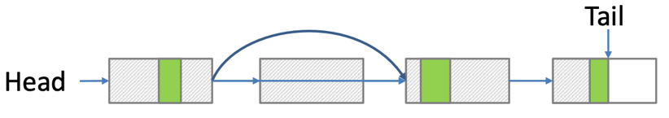
Fast garbage collection
Log is a linked list
Log only contains metadata
Fast GC deletes dead log pages from the linked list
No copying

Slide 57
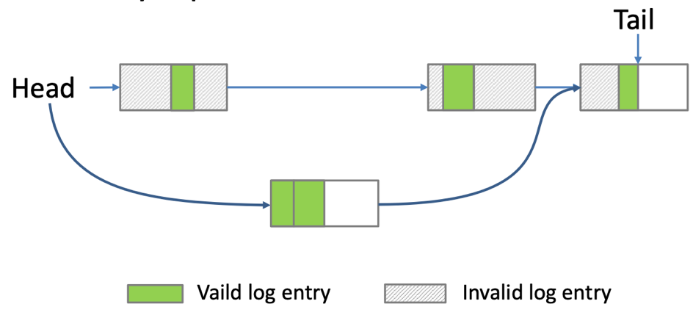
Thorough garbage collection
Starts if valid log entries < 50% log length
Format a new log and atomically replace the old one
Only copy metadata

Slide 58
Case study: Aerie
A final
[Volos, EuroSys’14]

Slide 59
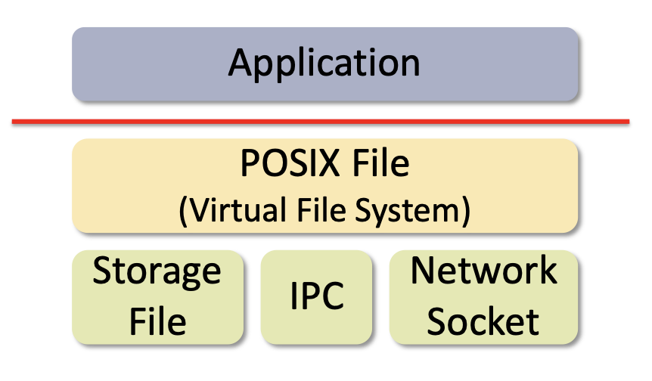
POSIX File: Expensive abstraction
Universal abstraction: Everything is a file
  Has generic-overhead cost

Slide 60
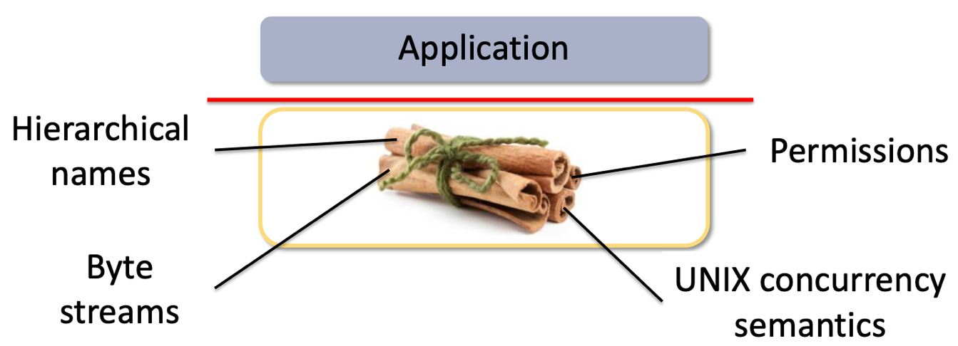
POSIX File: Expensive abstraction
Rigid interface and policies
  Has fixed components and costs
  Hinders application-specific customization

Slide 61
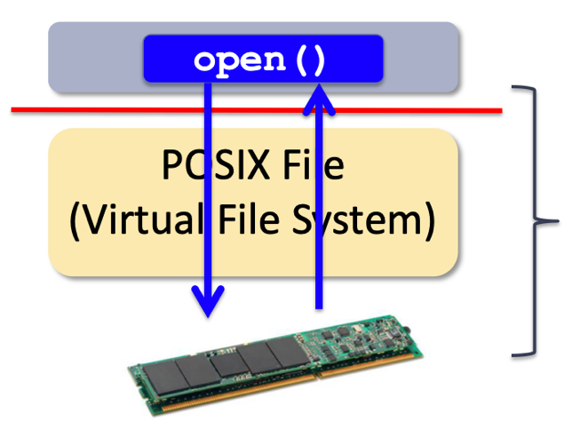
POSIX File: Expensive abstraction
Generic-overhead costs
Rigid interfaces and policies
~2.5us ≈ 25x NVM latency

Slide 62
Customizing the file system today
Modify the kernel
Add a layer over existing kernel file system
Use a user-mode framework such as FUSE
Need flexible interfaces

Slide 63
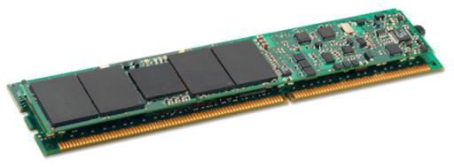
Kernel safely multiplexes NVM
Allocation: allocates NVM regions
Addressing: Memory-maps NVM regions
Protection: Keep track of region access rights
Kernel
allocation, protection, addressing
HW

Slide 64
Library implements functionality
APP
APP
APP
USER
API
API
API
LibFS
(layout, logic)
LibFS
(layout, logic)
Other LibFS
(layout, logic)
Kernel
allocation, protection, addressing
HW

Slide 65
Integrity via Trusted File Service
APP
APP
Trusted
FS
Service
(TFS)
USER
API
API
LibFS
(layout, logic)
Other LibFS
(layout, logic)
Kernel
allocation, protection, addressing
HW

Slide 66
Integrity via Trusted File Service
APP
Lease Manager
(sharing)
APP
Trusted
FS
Service
(TFS)
LibFS
Update
Metadata
Server
(integrity)
USER
API
LibFS
(layout, logic)
RPC
Read/
Write
Read/
Write
Read
HW
File data
Metadata

Slide 67
Questions
Notes:
Time: 1:18:00

